Slide 1

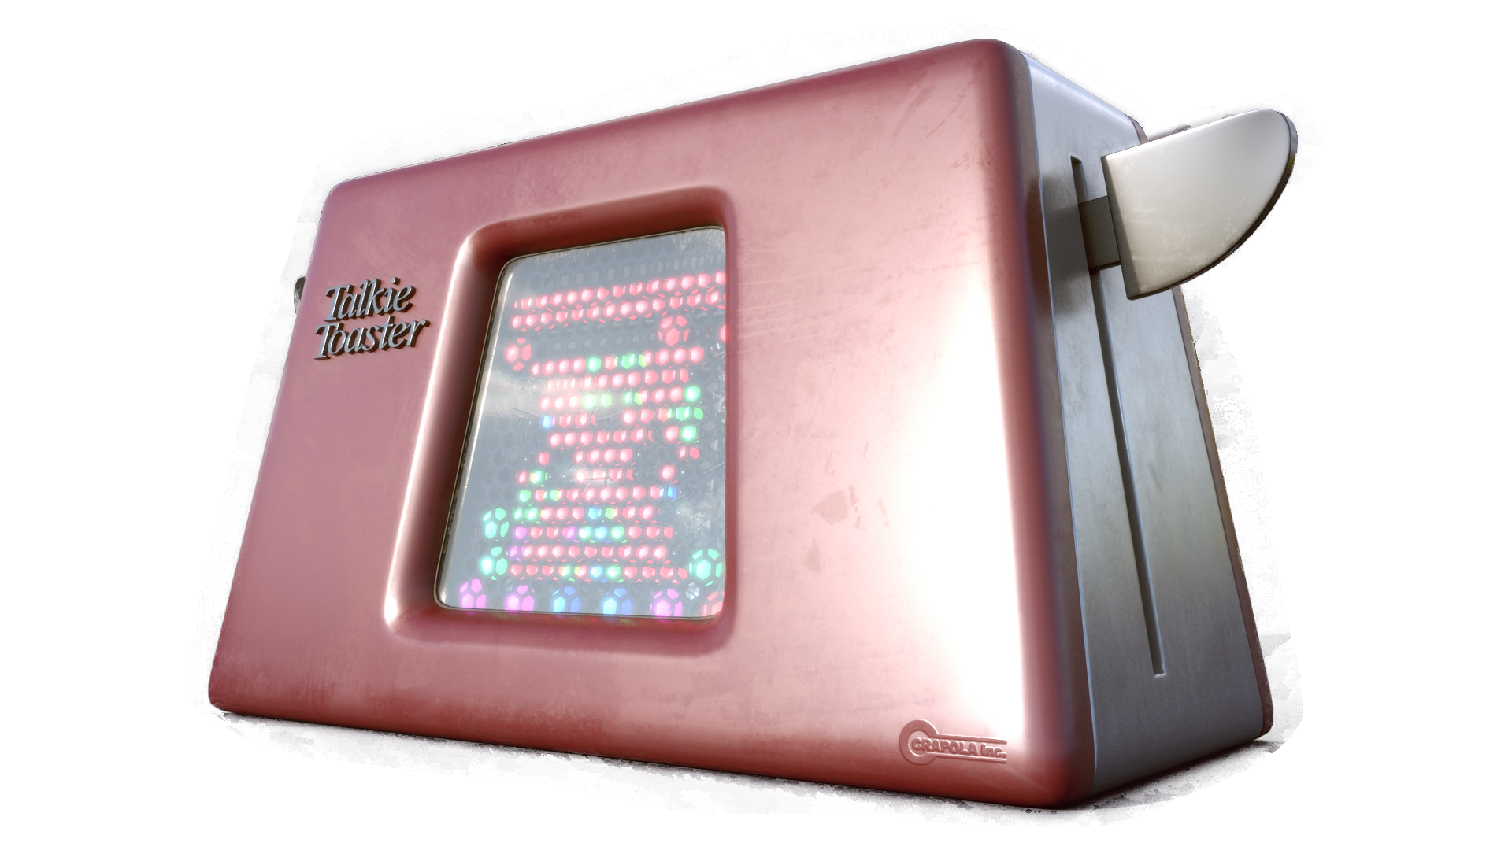
Did someone say they wanted toast?
Michael Turner - Raspberry Pint
Notes:
Spot the red dwarf quotes

Slide 2
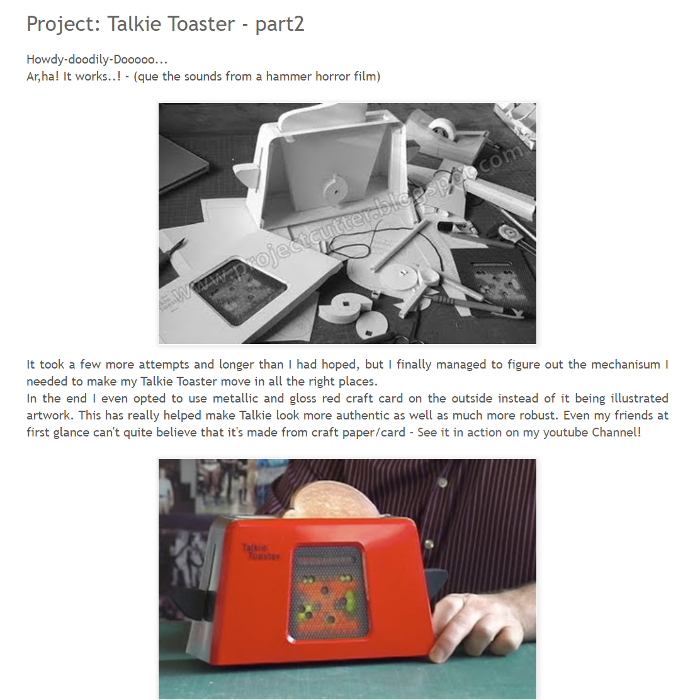
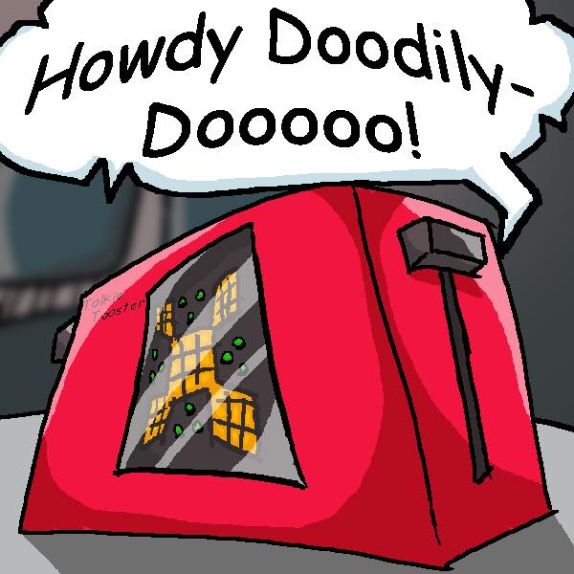
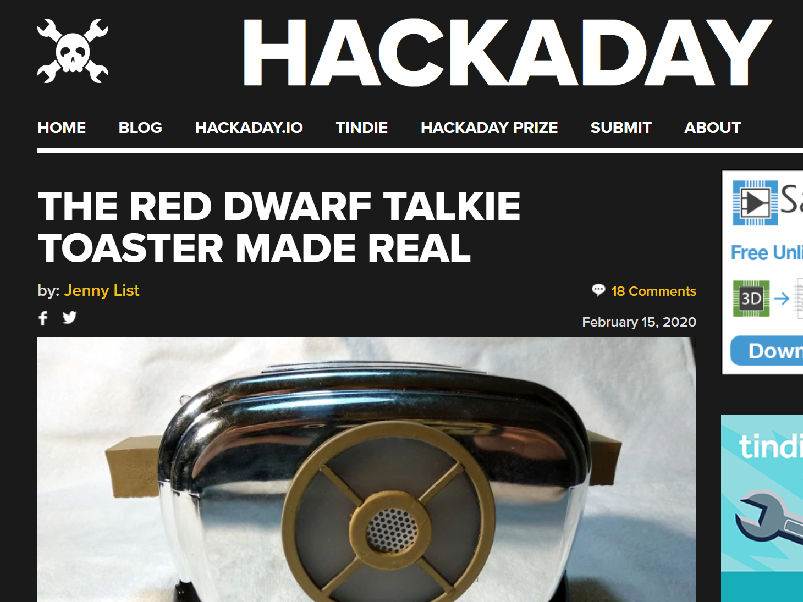
So what is it?
Optimization
Research
Planning
Notes:
small off duty Czechsolvakian traffic warden
A great idea with two minor flaws. I don’t have any skills at creating physical objects, and I don’t have any skills at creating physical objects. Now I realise that technically speaking that's only one flaw, but I thought it was such a big one it was worth mentioning twice!

Slide 3

Requirements
Off-Line
Doesn’t need an Internet connection + Doesn’t give everything it hears to the cloud
Continuous
Must be able to run constantly, not just listen for a single wake-up word
Run on an RPi
Low-powered and simple enough to run on a Raspberry Pi
Notes:
Google / Amazon API limitations

Slide 4
What’s Available?
snowboy
PocketSphinx
Vosk-API
Notes:
Voice assistants

Slide 5
snowboy
Pros | Cons
Very accurate | Few useful generic words
Low CPU usage | Trains to just your voice
Simple to train | Support ends in December 2020
 | Every trigger must be individually trained
Notes:
Killed by only working for me

Slide 6
Pocket Sphinx
Pros | Cons
No training required | Requires a lot of tuning
Flexible | Out the box it barely works
Simple | Heavy CPU usage (RPi 3 or later required)
 | Randomly detects words from any noise
Notes:
Killed by just being too inaccurate and constantly triggering

Slide 7
Vosk API
Pros | Cons
No training required | Can be laggy
Flexible | Heavy CPU usage (RPi 3 or later required)
No tuning required | Does get some words wrong
Reasonably accurate
Notes:
Watching the output: “strike a light”. This is exactly what I need.

Slide 8
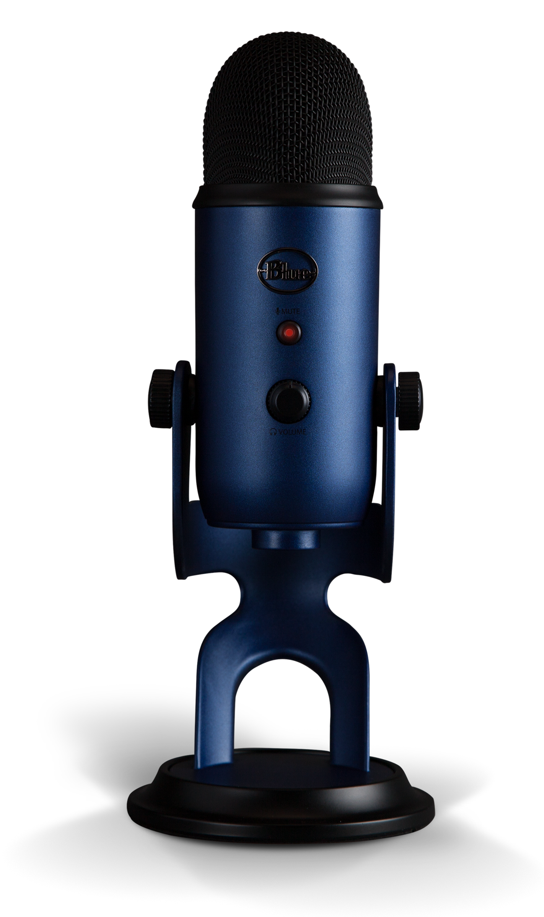
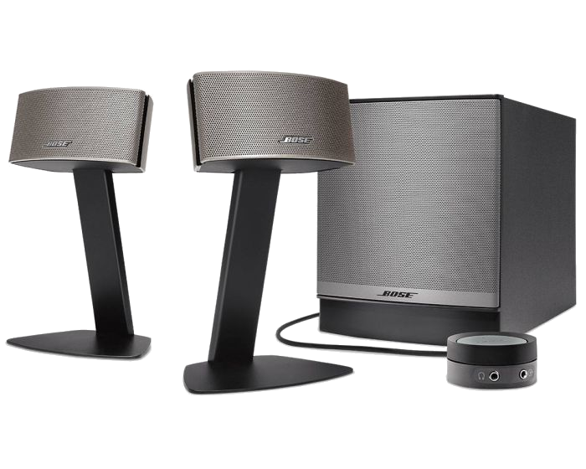
USB Equipment
Notes:
What could possibly be amiss? Bose speakers crashed
Microphone too directional / need to be close
What are we going to do with them Mr Flibble? (then next slide)

Slide 9
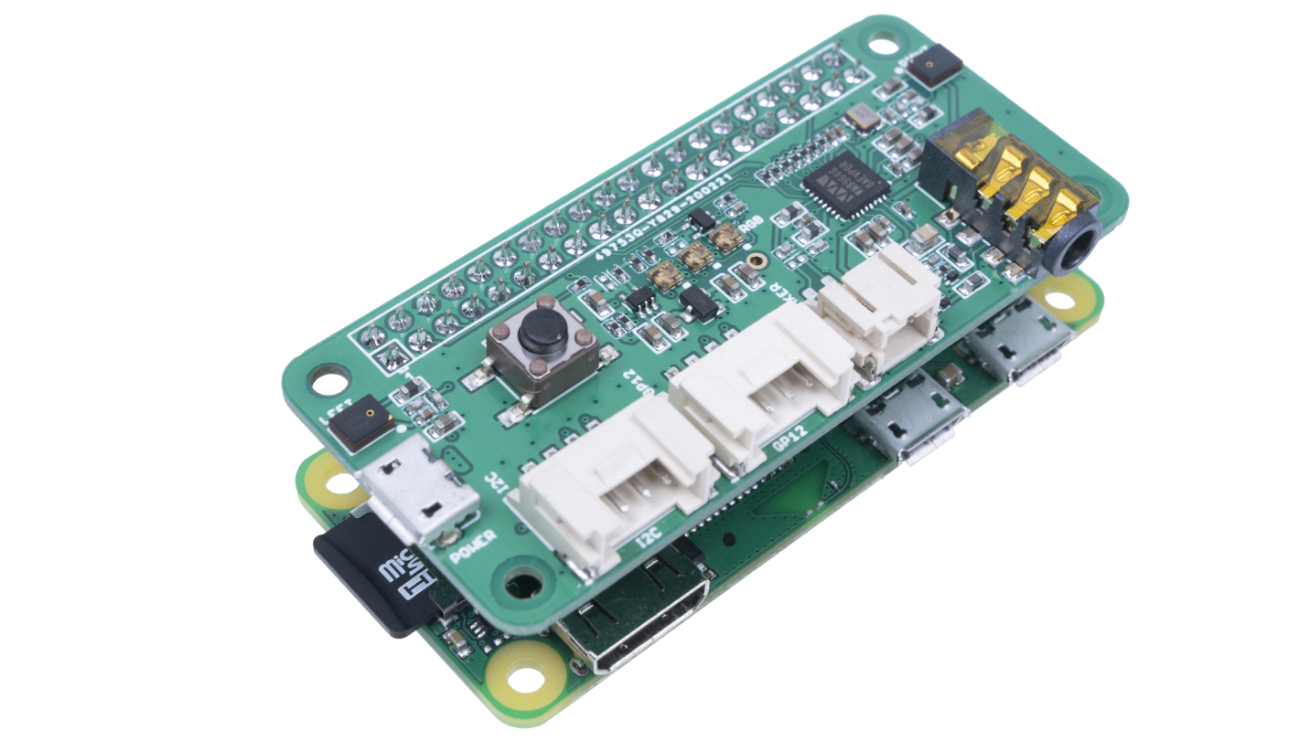
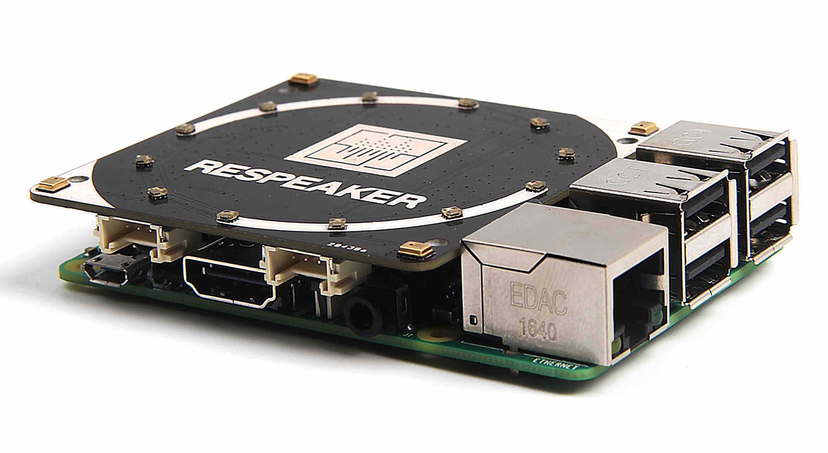
Better equipment
ReSpeaker 2 by Seeed
ReSpeaker 4 by Seeed
Drive Speaker Directly
Button
Low Cost (£12)
Two Microphones
No Speaker Capabilities
No Button
Higher Cost (£28)
Four Microphones
Notes:
Works at greater distance
Only one I2S bus available
Drivers not in standard kernel
Automated install process works perfectly

Slide 10
Install Problems
Install
Many ways to install some are simple others not
Dependencies missed but not identified
Audio
ALSA crashing
Device ID needs selection as vary a lot
Only one I2S connection possible
Notes:
ALSA required Pulse Audio installing. Used in preference.

Slide 11
So what is it?
Just Kidding!!
Optimization
Research
Planning
Notes:
small off duty Czechsolvakian traffic warden
A great idea with two minor flaws. I don’t have any skills at creating physical objects, and I don’t have any skills at creating physical objects. Now I realise that technically speaking that's only one flaw, but I thought it was such a big one it was worth mentioning twice!

Slide 12
Software Interaction
snowboy
Simple hear this then play that
Hard coded within python script
PocketSphinx
JSON configuration file
Loads all keywords to pass to pocketsphinx
Supported some conversation paths
Vosk-API
Expanded on previous JSON format
Doesn’t require keyword list built at startup
Made conversation paths more flexible
Only worked effectively with around 8 to 12 letters per phrase
Supported more complex combinations
Notes:
Snowboy wouldn’t scale well due to training
Pocketsphinx had sensitivity per keyword

Slide 13
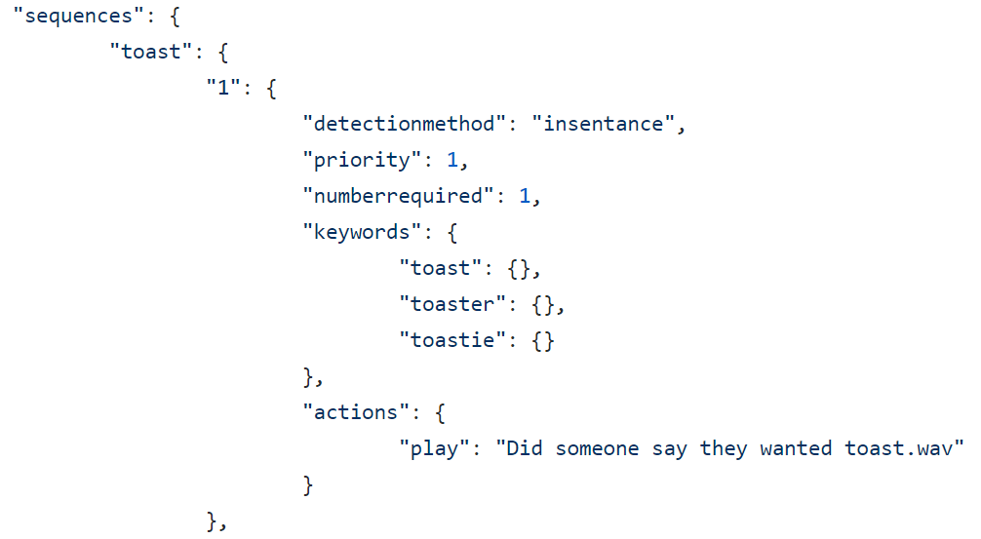
Simple Interaction
Notes:
Say sorry for spelling
Priority – higher is more important

Slide 14
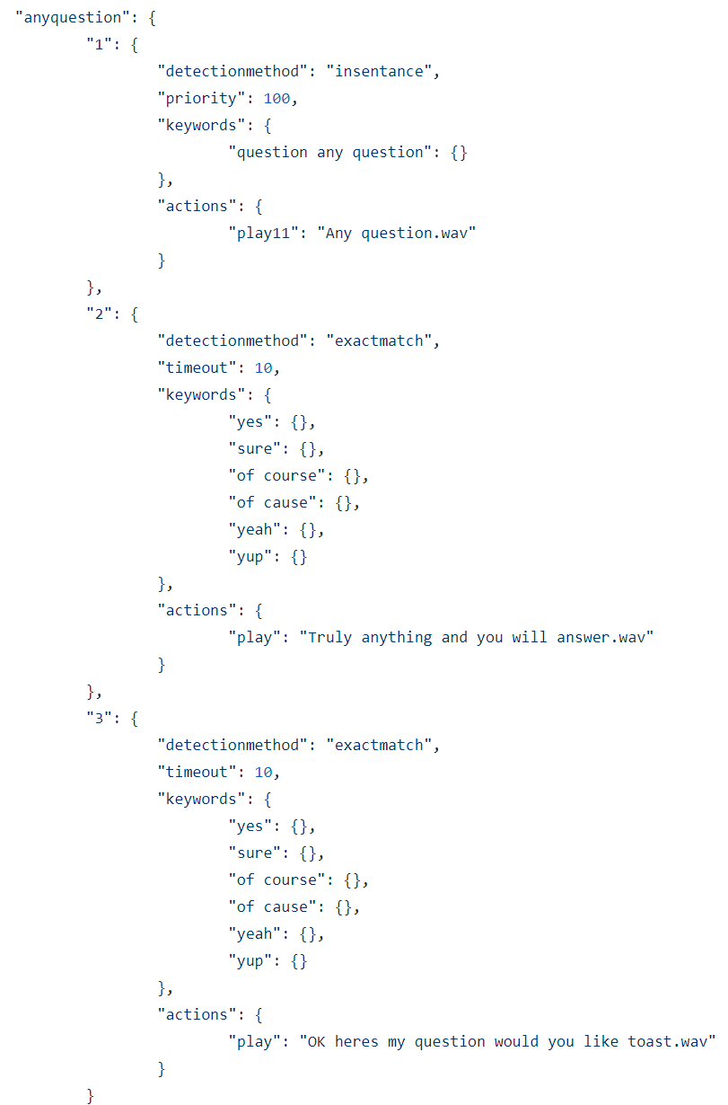
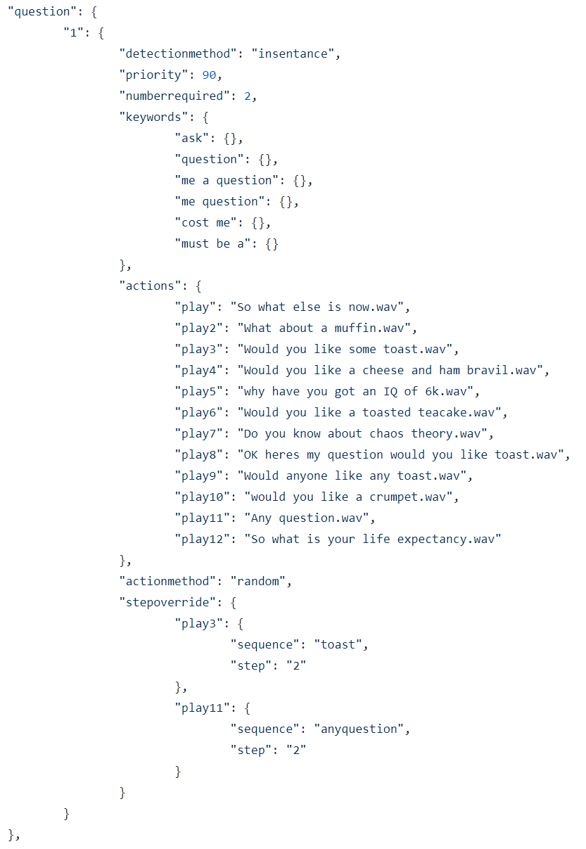
Complex Interaction
Notes:
Point out priority
Number required
Timeout not in step 1.

Slide 15
Practical Demo
I’m not pished
What could go wrong?

Slide 16

Thank You!
mjt@mjturner.co.uk
@trikkitt
https://github.com/Trikkitt/talkietoaster
www.trikkitt.com
You’ve been smegging awesome!

